Slide 1
Chapter 2 – Demand/Supply - Equilibrium
Develop the concepts of demand and supply.
Discuss the factors that lead to shifts in the demand and supply curves.
Explain how prices and output are determined in product markets through the interaction of demand and supply.
Copyright © 2004 McGraw-Hill Australia Pty Ltd
PPTs t/a Microeconomics 7/e by Jackson and McIver
Slides prepared by Muni Perumal, University of Canberra, Australia.

Slide 2
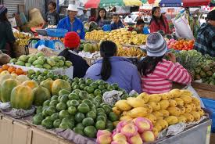
Markets
A market is any institutional structure, or mechanism, that brings together buyers and sellers of particular goods and services
Markets exists in many forms
They determine the price and quantity of a good or service transacted
Copyright © 2004 McGraw-Hill Australia Pty Ltd
PPTs t/a Microeconomics 7/e by Jackson and McIver
Slides prepared by Muni Perumal, University of Canberra, Australia.

Slide 3

Demand
The various amounts of a product that consumers are willing and able to purchase at various prices during some specific period
Demonstrated by demand schedule and demand curve
Copyright © 2004 McGraw-Hill Australia Pty Ltd
PPTs t/a Microeconomics 7/e by Jackson and McIver
Slides prepared by Muni Perumal, University of Canberra, Australia.

Slide 4

Law of Demand
The inverse relationship between the price and the quantity demanded of a good or service during some period of time
Copyright © 2004 McGraw-Hill Australia Pty Ltd
PPTs t/a Microeconomics 7/e by Jackson and McIver
Slides prepared by Muni Perumal, University of Canberra, Australia.

Slide 5
Law of Demand (cont.)
Based on:
1. Income effect
2. Substitution effect
3. Diminishing marginal utility
Copyright © 2004 McGraw-Hill Australia Pty Ltd
PPTs t/a Microeconomics 7/e by Jackson and McIver
Slides prepared by Muni Perumal, University of Canberra, Australia.

Slide 6
Income Effect
At a lower price, consumers can buy more of a product without giving up other goods
A decline in price increases the purchasing power of money/real income
Copyright © 2004 McGraw-Hill Australia Pty Ltd
PPTs t/a Microeconomics 7/e by Jackson and McIver
Slides prepared by Muni Perumal, University of Canberra, Australia.

Slide 7
Substitution Effect
At a lower price, consumers have the incentive to substitute the cheaper good for similar goods that are now relatively more expensive
Copyright © 2004 McGraw-Hill Australia Pty Ltd
PPTs t/a Microeconomics 7/e by Jackson and McIver
Slides prepared by Muni Perumal, University of Canberra, Australia.

Slide 8
Diminishing Marginal Utility
States that successive units of a given product yield less and less extra satisfaction
Therefore, consumers will only buy more of a good if its price is reduced
Copyright © 2004 McGraw-Hill Australia Pty Ltd
PPTs t/a Microeconomics 7/e by Jackson and McIver
Slides prepared by Muni Perumal, University of Canberra, Australia.

Slide 9
Demand Curve
Shows the inverse relationship between price and quantity demanded for a good or service
Derived from a demand schedule showing the quantity demanded at various prices
Copyright © 2004 McGraw-Hill Australia Pty Ltd
PPTs t/a Microeconomics 7/e by Jackson and McIver
Slides prepared by Muni Perumal, University of Canberra, Australia.

Slide 10
Demand
Price Quantity demanded
per unit per week
a 5 10
b 4 20
c 3 35
d 2 55
e 1 80
Copyright © 2004 McGraw-Hill Australia Pty Ltd
PPTs t/a Microeconomics 7/e by Jackson and McIver
Slides prepared by Muni Perumal, University of Canberra, Australia.

Slide 11
Graphing Demand
P
D₁
a
5
4
3
2
1
b
c
Price ($ per unit)
d
e
D₁
0
Q
10 20 30 40 50 60 70 80
Quantity demanded (units per week)
Copyright © 2004 McGraw-Hill Australia Pty Ltd
PPTs t/a Microeconomics 7/e by Jackson and McIver
Slides prepared by Muni Perumal, University of Canberra, Australia.

Slide 12
Individual and Market Demand
Market demand is derived by horizontally summing individual demand curves
Market demand is derived by adding all the quantities demanded in a demand schedule which correspond to their prices
Copyright © 2004 McGraw-Hill Australia Pty Ltd
PPTs t/a Microeconomics 7/e by Jackson and McIver
Slides prepared by Muni Perumal, University of Canberra, Australia.

Slide 13
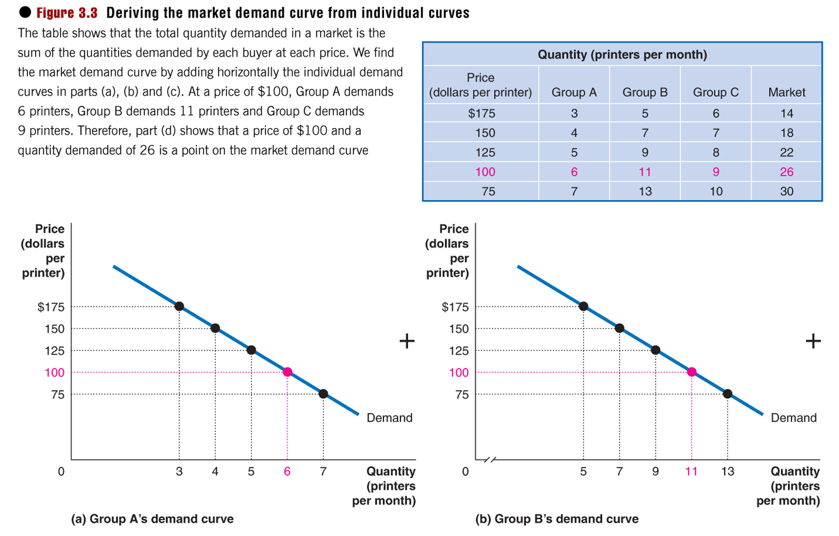
Deriving the market demand curve from individual curves: Figure 3.3
Notes:
The table shows that the total quantity demanded in a market is the sum of the quantities demanded by each buyer at each price. We find the market demand curve by adding horizontally the individual demand curves in parts (a), (b) and (c). At a price of $100, Group A demands 6 printers, Group B demands 11 printers and Group C demands 9 printers. Therefore, part (d) shows that a price of $100 and a quantity demanded of 26 is a point on the market demand curve.

Slide 14
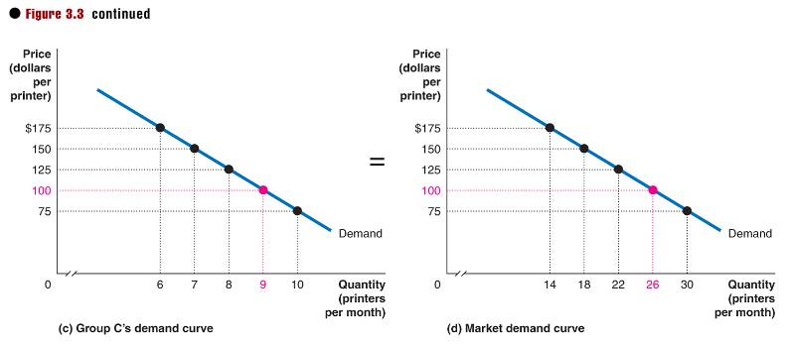
Deriving the market demand curve from individual curves: Figure 3.3, continued

Slide 15
Changes in Demand
Caused by changes in one or other of the non-price determinants of demand
Represented as a shift of the demand curve either to the right or left
Represents a change in the quantity demand at every price, so cannot be related to a change in price
Copyright © 2004 McGraw-Hill Australia Pty Ltd
PPTs t/a Microeconomics 7/e by Jackson and McIver
Slides prepared by Muni Perumal, University of Canberra, Australia.

Slide 16
Changes in Demand
Tastes or preferences
Number of buyers
Income
  Normal or superior goods—demand varies directly with income
  Inferior goods—demand varies inversely with income
Copyright © 2004 McGraw-Hill Australia Pty Ltd
PPTs t/a Microeconomics 7/e by Jackson and McIver
Slides prepared by Muni Perumal, University of Canberra, Australia.

Slide 17
Changes in Demand (cont.)
Prices of related goods
  Substitute goods
  Complementary goods
  Independent goods
Expectations
Seasons/weather
Copyright © 2004 McGraw-Hill Australia Pty Ltd
PPTs t/a Microeconomics 7/e by Jackson and McIver
Slides prepared by Muni Perumal, University of Canberra, Australia.

Slide 18
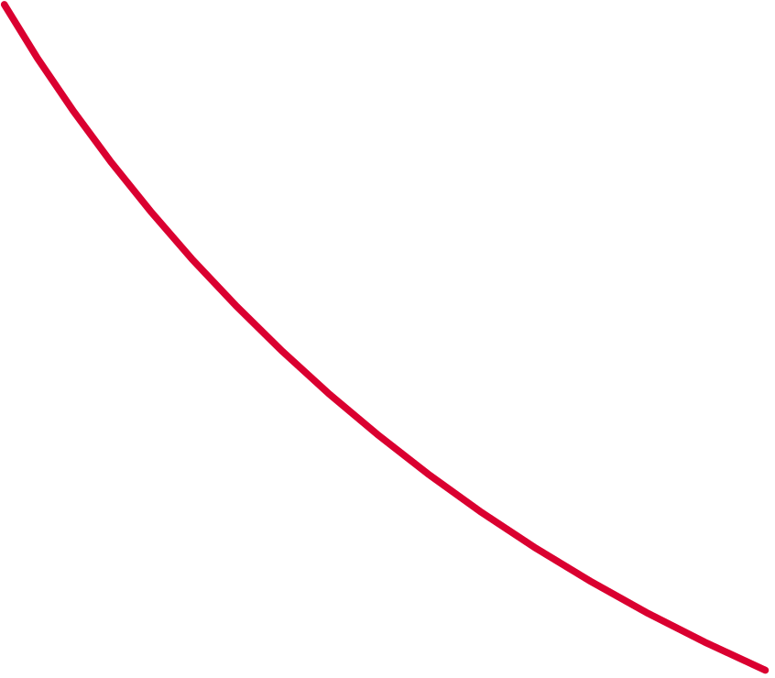
Increase in Demand
D₂
P
D₁
5
4
3
2
1
Increase in
Demand
Price ($ per unit)
D₂
D₁
0
10 20 30 40 50 60 70 80
Q
Quantity demanded
Copyright © 2004 McGraw-Hill Australia Pty Ltd
PPTs t/a Microeconomics 7/e by Jackson and McIver
Slides prepared by Muni Perumal, University of Canberra, Australia.

Slide 19
Decrease in Demand
P
D₁
Decrease in
Demand
5
4
3
2
1
D₃
Price ($ per unit)
D₁
D₃
0
10 20 30 40 50 60 70 80
Q
Quantity demanded
Copyright © 2004 McGraw-Hill Australia Pty Ltd
PPTs t/a Microeconomics 7/e by Jackson and McIver
Slides prepared by Muni Perumal, University of Canberra, Australia.

Slide 20
Changes in Quantity Demand
caused by changes in price only
represented as movement along a demand curve
other factors determining demand are held constant
Copyright © 2004 McGraw-Hill Australia Pty Ltd
PPTs t/a Microeconomics 7/e by Jackson and McIver
Slides prepared by Muni Perumal, University of Canberra, Australia.

Slide 21
Movement along a Curve
P
D₁
5
4
3
2
1
Movement along
a demand curve
Price ($ per unit)
Change in
quantity demanded
D₁
0
10 20 30 40 50 60 70 80
Q
Quantity demanded
Copyright © 2004 McGraw-Hill Australia Pty Ltd
PPTs t/a Microeconomics 7/e by Jackson and McIver
Slides prepared by Muni Perumal, University of Canberra, Australia.

Slide 22
Supply
The various amounts of a product that producers are willing and able to supply at various prices during some specific period
Demonstrated by the supply schedule and supply curve
Copyright © 2004 McGraw-Hill Australia Pty Ltd
PPTs t/a Microeconomics 7/e by Jackson and McIver
Slides prepared by Muni Perumal, University of Canberra, Australia.

Slide 23
Law of Supply
Direct relationship between the price and quantity supplied
Increased price causes increased quantity supplied
Decreased price causes decreased quantity supplied
Related to cost-plus pricing model, i.e. as quantity increases costs often increase so firm need a higher P to increase Q.
Copyright © 2004 McGraw-Hill Australia Pty Ltd
PPTs t/a Microeconomics 7/e by Jackson and McIver
Slides prepared by Muni Perumal, University of Canberra, Australia.

Slide 24
Market Supply
Price Quantity supplied
per unit($) per week
a 5 12 000
b 4 10 000
c 3 7 000
d 2 4 000
e 1 1 000
Copyright © 2004 McGraw-Hill Australia Pty Ltd
PPTs t/a Microeconomics 7/e by Jackson and McIver
Slides prepared by Muni Perumal, University of Canberra, Australia.

Slide 25
Supply Curve
P
a
S₁
5
4
3
2
1
b
c
Price ($ per unit)
d
e
S₁
Q
0
2 4 6 8 10 12 14 16
Quantity supplied (000/week)
Copyright © 2004 McGraw-Hill Australia Pty Ltd
PPTs t/a Microeconomics 7/e by Jackson and McIver
Slides prepared by Muni Perumal, University of Canberra, Australia.

Slide 26
Change in Supply
represented as a shift of the supply curve
caused by changes in determinants of supply other than price
Copyright © 2004 McGraw-Hill Australia Pty Ltd
PPTs t/a Microeconomics 7/e by Jackson and McIver
Slides prepared by Muni Perumal, University of Canberra, Australia.

Slide 27
Increase in Supply
P
S₁
5
4
3
2
1
S₂
Price ($ per unit)
S₁
S₂
Q
0
2 4 6 8 10 12 14 16
Quantity supplied (000/week)
Copyright © 2004 McGraw-Hill Australia Pty Ltd
PPTs t/a Microeconomics 7/e by Jackson and McIver
Slides prepared by Muni Perumal, University of Canberra, Australia.

Slide 28
Decrease in Supply
P
S₃
S₁
5
4
3
2
1
Price ($ per unit)
S₃
S₁
Q
0
2 4 6 8 10 12 14 16
Quantity supplied (000/week)
Copyright © 2004 McGraw-Hill Australia Pty Ltd
PPTs t/a Microeconomics 7/e by Jackson and McIver
Slides prepared by Muni Perumal, University of Canberra, Australia.

Slide 29
Non-price determinants of Supply
Resource price
Technology
Prices of other goods
Expectations
Number of sellers
[Note mostly related to changing costs of production reflecting marginal cost curve]
Copyright © 2004 McGraw-Hill Australia Pty Ltd
PPTs t/a Microeconomics 7/e by Jackson and McIver
Slides prepared by Muni Perumal, University of Canberra, Australia.

Slide 30
Changes in Quantity Supplied
Caused by changes in price only
Represented as a movement along a supply curve
Copyright © 2004 McGraw-Hill Australia Pty Ltd
PPTs t/a Microeconomics 7/e by Jackson and McIver
Slides prepared by Muni Perumal, University of Canberra, Australia.

Slide 31
Movement along a Supply Curve
P
S₁
5
4
3
2
1
Price ($ per unit)
Movement along
a supply curve
S₁
Q
0
2 4 6 8 10 12 14 16
Quantity supplied (000/week)
Copyright © 2004 McGraw-Hill Australia Pty Ltd
PPTs t/a Microeconomics 7/e by Jackson and McIver
Slides prepared by Muni Perumal, University of Canberra, Australia.

Slide 32
Movement along a Supply Curve
P
S₁
$5
4
3
2
1
Price ($ per unit)
Movement along
a supply curve
S₁
Q
0
2 4 6 8 10 12 14 16
Quantity supplied (000/week)
Copyright © 2004 McGraw-Hill Australia Pty Ltd
PPTs t/a Microeconomics 7/e by Jackson and McIver
Slides prepared by Muni Perumal, University of Canberra, Australia.

Slide 33
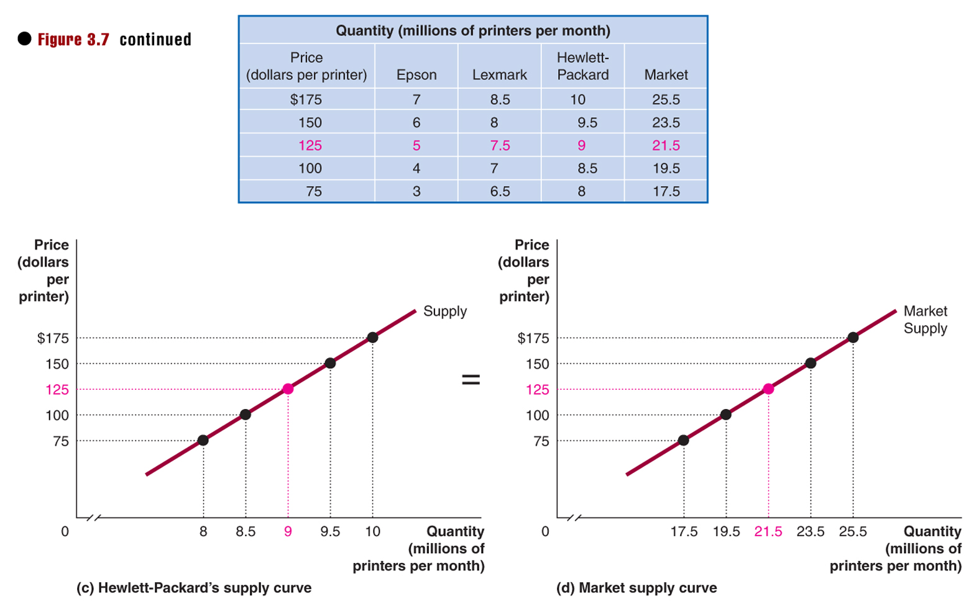
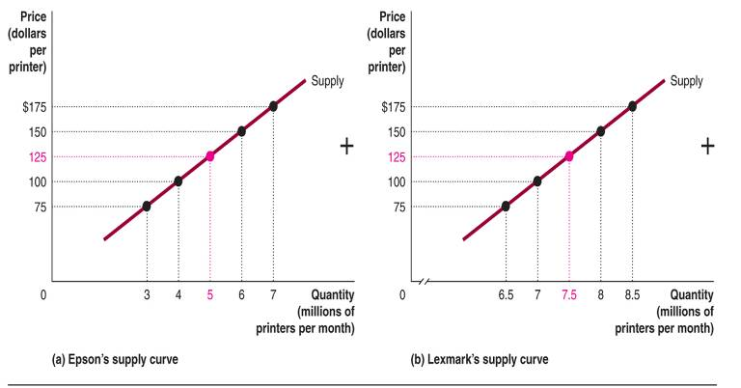
Deriving the market supply curve from individual curves
Notes:
The table shows that the total quantity supplied in a market is the sum of the quantities supplied by each seller. We can find the market supply curve by adding horizontally the individual supply curves. For example, at a price of $125, Epson supplies five million printers, Lexmark supplies 7.5 million printers and H-P supplies nine million printers. Therefore, the quantity supplied in the market at a price of $125 is 21.5 million printers.

Slide 34
Deriving the market supply curve from individual curves
Hubbard, Garnett, Lewis and O’Brien: Essentials of Economics © 2010 Pearson Australia

Slide 35
Market Equilibrium
Occurs when the buying decisions of households and the selling decisions of producers are equated
Determines the equilibrium price and equilibrium quantity bought and sold in the market
Copyright © 2004 McGraw-Hill Australia Pty Ltd
PPTs t/a Microeconomics 7/e by Jackson and McIver
Slides prepared by Muni Perumal, University of Canberra, Australia.

Slide 36

Market Equilibrium (cont.)
P
5
4
3
2
1
S
Equilibrium price
Price ($ per unit)
D
0
Q
2 4 6 7 8 10 12 14 16 18
Units of X (000/week)
Copyright © 2004 McGraw-Hill Australia Pty Ltd
PPTs t/a Microeconomics 7/e by Jackson and McIver
Slides prepared by Muni Perumal, University of Canberra, Australia.

Slide 37
Market Equilibrium (cont.)
P
5
4
3
2
1
S
surplus
Equilibrium price
Price ($ per unit)
D
0
Q
2 4 6 7 8 10 12 14 16 18
Units of X (000/week)
Copyright © 2004 McGraw-Hill Australia Pty Ltd
PPTs t/a Microeconomics 7/e by Jackson and McIver
Slides prepared by Muni Perumal, University of Canberra, Australia.

Slide 38
Market Equilibrium (cont.)
P
5
4
3
2
1
S
surplus
Equilibrium price
Price ($ per unit)
shortage
D
0
Q
2 4 6 7 8 10 12 14 16 18
Units of X (000/week)
Copyright © 2004 McGraw-Hill Australia Pty Ltd
PPTs t/a Microeconomics 7/e by Jackson and McIver
Slides prepared by Muni Perumal, University of Canberra, Australia.

Slide 39
Shortage (Excess Demand)
Occurs when the quantity demanded exceeds the quantity supplied at the current price
Competition amongst buyers eventually bids up the price until equilibrium is reached
Copyright © 2004 McGraw-Hill Australia Pty Ltd
PPTs t/a Microeconomics 7/e by Jackson and McIver
Slides prepared by Muni Perumal, University of Canberra, Australia.

Slide 40
Surplus (Excess Supply)
Occurs when the quantity supplied exceeds the quantity demanded at the current price
Competition amongst producers eventually causes the price to decline until equilibrium is reached
Copyright © 2004 McGraw-Hill Australia Pty Ltd
PPTs t/a Microeconomics 7/e by Jackson and McIver
Slides prepared by Muni Perumal, University of Canberra, Australia.

Slide 41
Changes in Demand and Supply
Changes or shifts will disrupt the equilibrium
The market will adjust until once again an equilibrium is reached
The equilibrium price and quantity traded will change
Copyright © 2004 McGraw-Hill Australia Pty Ltd
PPTs t/a Microeconomics 7/e by Jackson and McIver
Slides prepared by Muni Perumal, University of Canberra, Australia.

Slide 42
Increase in Demand
P
D₂
D₁
S
Equilibrium
price & quantity
rise
D₂
D₁
0
Q
Copyright © 2004 McGraw-Hill Australia Pty Ltd
PPTs t/a Microeconomics 7/e by Jackson and McIver
Slides prepared by Muni Perumal, University of Canberra, Australia.

Slide 43
Decrease in Demand
P
D₂
D₁
S
Equilibrium
price & quantity
fall
D₁
D₂
0
Q
Copyright © 2004 McGraw-Hill Australia Pty Ltd
PPTs t/a Microeconomics 7/e by Jackson and McIver
Slides prepared by Muni Perumal, University of Canberra, Australia.

Slide 44
Increase in Supply
P
S₁
D₁
S₂
Equilibrium
price falls & quantity
rises
S₁
D₁
S₂
0
Q
Copyright © 2004 McGraw-Hill Australia Pty Ltd
PPTs t/a Microeconomics 7/e by Jackson and McIver
Slides prepared by Muni Perumal, University of Canberra, Australia.

Slide 45
Decrease in Supply
P
S₂
D₁
S₁
Equilibrium
price rises & quantity
falls
S₂
S₁
D₁
0
Q
Copyright © 2004 McGraw-Hill Australia Pty Ltd
PPTs t/a Microeconomics 7/e by Jackson and McIver
Slides prepared by Muni Perumal, University of Canberra, Australia.

Slide 46
Both Demand & Supply Increase
P
D₂
D₁
S₁
Quantity will increase but price change will be in determinant
S₂
S₁
D₂
D₁
S₂
0
Q
Copyright © 2004 McGraw-Hill Australia Pty Ltd
PPTs t/a Microeconomics 7/e by Jackson and McIver
Slides prepared by Muni Perumal, University of Canberra, Australia.

Slide 47
Demand or Supply change
Increase in D: P increases; Q decreases
Decrease in D: P decreases; Q increases
Increase in S: P decreases; Q increases
Decrease in S: P increases; Q decreases
Copyright © 2004 McGraw-Hill Australia Pty Ltd
PPTs t/a Microeconomics 7/e by Jackson and McIver
Slides prepared by Muni Perumal, University of Canberra, Australia.

Slide 48
Both Demand & Supply change
Demand increases and supply increases;
Q must rise but P??
Demand increases and supply decreases;
P must rise but Q??
Demand decreases and supply increases;
P must fall but Q??
Demand decreases and supply decreases;
Q must fall but P??

Slide 49
Both Demand & Supply change
The overall change in the indeterminate side of the market, i.e. P or Q depends on the relative shifts in DD and SS.
Copyright © 2004 McGraw-Hill Australia Pty Ltd
PPTs t/a Microeconomics 7/e by Jackson and McIver
Slides prepared by Muni Perumal, University of Canberra, Australia.

Slide 50
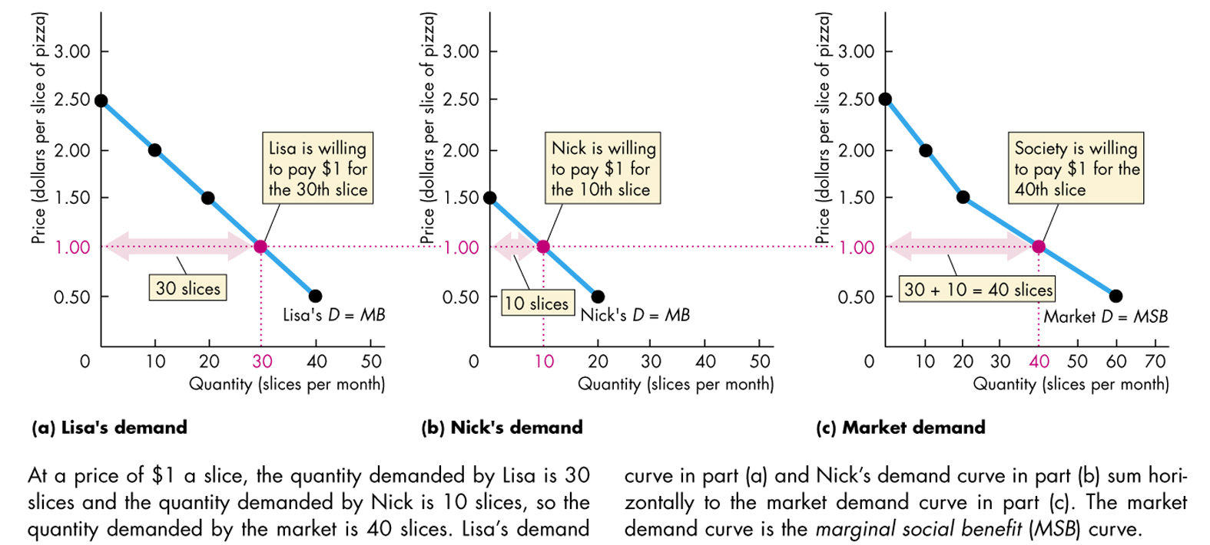
Individual Demand and Market Demand
Figure 5.1

Slide 51
Demand, Marginal Benefit, and Consumer Surplus
Consumer surplus
  Consumer surplus is the value of a good minus the price paid for it, summed over the quantity bought.
  It is measured by the area under the demand curve and above the price paid, up to the quantity bought.
  Figure 5.2 on the next slide shows the consumer surplus for pizza for an individual consumer.

Slide 52
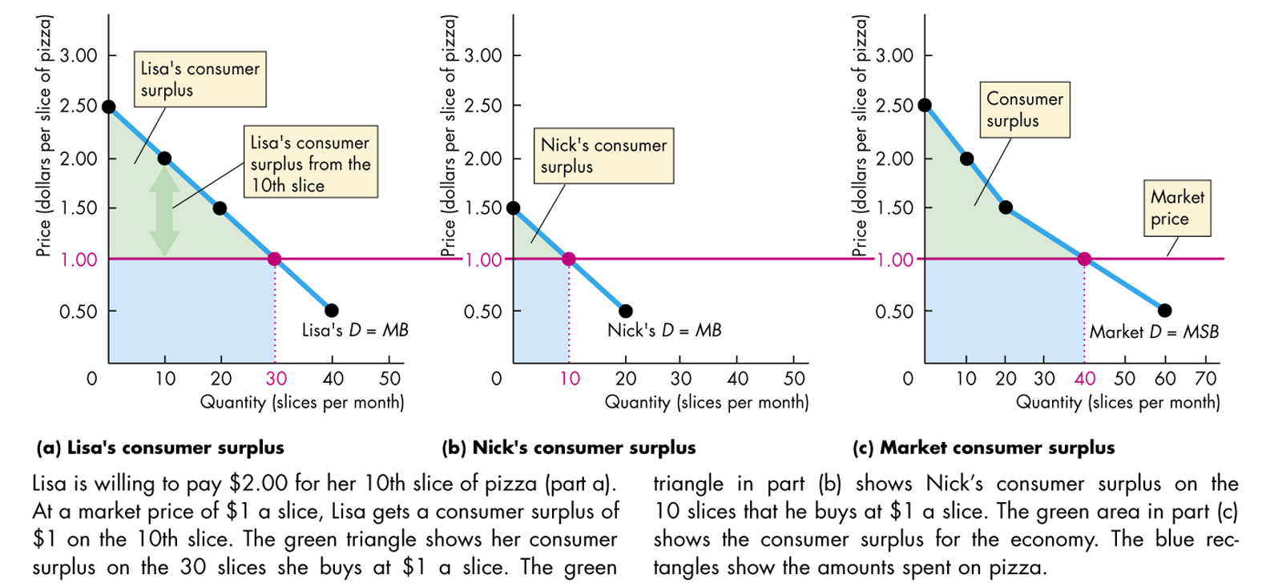
Demand and Consumer Surplus
Figure 5.2

Slide 53
Supply, Marginal Cost, and Producer Surplus
Supply, cost, and minimum supply price
  The cost of one more unit of a good or service is its marginal cost, which we can measure as minimum price that a firm is willing to accept.
  A supply curve of a good or service shows the quantity supplied at each price.
  A supply curve is a marginal cost curve.

Slide 54
Cost, Price, and Producer Surplus
Producer surplus
  Producer surplus is the price of a good minus the marginal cost of producing it, summed over the quantity sold.
  Producer surplus is measured by the area below the price and above the supply curve, up to the quantity sold.
  Figure 5.4 on the next slide shows the producer surplus for pizza for an individual producer.

Slide 55
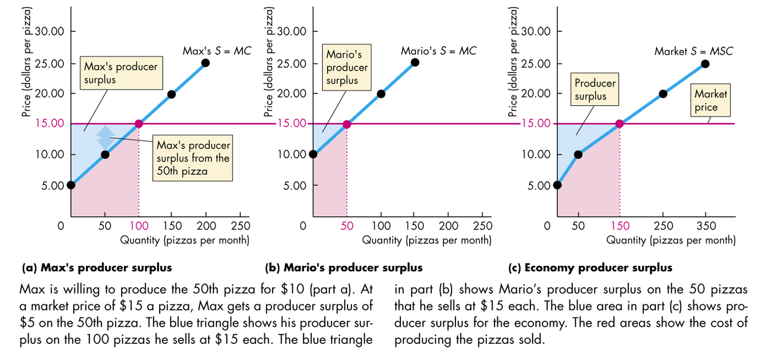
Supply and Producer Surplus
Figure 5.4

Slide 56
Is the Competitive Market Efficient?
Efficiency of competitive equilibrium
  A competitive market creates an efficient allocation of resources at equilibrium.
  In equilibrium, the quantity demanded equals the quantity supplied.

Slide 57
An Efficient Market for Pizza
Figure 5.5(a)
Consumer
surplus
S
25
20
Price (dollars per pizza)
Equilibrium
15
10
5
Producer
surplus
Equilibrium quantity
D
0 5 10 15 20
Quantity (thousands of pizzas per day)

Slide 58
Is the Competitive Market Efficient?
  At the equilibrium quantity, marginal benefit equals marginal cost, so the quantity is the efficient quantity.
  The sum of consumer and producer surplus is maximised at this efficient level of output.

Slide 59
Is the Competitive Market Efficient?
Underproduction and overproduction
  Obstacles to efficiency lead to underproduction or overproduction and create a deadweight loss.
Deadweight loss
  The decrease in consumer and producer surplus that results from an inefficient allocation of resources

Slide 60
Underproduction
Figure 5.6(a)
Deadweight
loss
S
25
20
Price (dollars per pizza)
15
Efficient
output
10
If output is
reduced to
5,000
5
D
0 5 10 15 20
Quantity (thousands of pizzas per day)

Slide 61
Overproduction
Figure 5.6(b)
S
25
20
Price (dollars per pizza)
Deadweight
loss
15
10
5
If output
is increased to
15,000 pizzas
D
0 5 10 15 20
Quantity (thousands of pizzas per day)

